Slide 1
An Introduction to Sequencing in Pd
BMus/BSc - Level 4
Dr Mat Dalgleish
mathewdalgleish@gmail.com

Slide 2
Assumptions
Students are diverse - mixed interests, largely inexperienced in programming.
There’s been a previous session introducing the module (LOs, assignment briefs, etc.) and introducing basics of Pd.
Access to a Mac lab (Pd, Logic).

Slide 3
Session Overview
Pure Data (recap)
Where can Pd used?
Sequencers - examples
Building a sequencer… in a modular way
Pd => IAC => Logic
Task (for later)

Slide 4
Materials
Today’s materials (these slides and Pd patches) are available at:
https://github.com/matdwlv/bcu
or
https://tinyurl.com/2s4jtz6e

Slide 5


Slide 6
Pure Data
An open source visual programming environment originally developed by Miller Puckette.
Part of the Max family.
Main flavours:
Pd vanilla - by Puckette.
Purr Data - ported to a HTML5 GUI.
Pd-L2Ork - same HTML5 GUI port used in Purr Data but different additional externals.

Slide 7
Where can Pd be used?
Desktop/laptop (Win/OSX/Linux)
Embedded devices - Bela, Raspberry Pi, Qubit Nebulae (Eurorack), etc.
Smartphones via LibPD, DroidParty (Android), and PdParty (iOS).
VST and AU hosts via Camomile.

Slide 8
Sequencing
“[....] programming a set of stored values that can be recalled and sent to any musical destination [....] typically providing note values, rhythms, or articulations” (Farnell, 2010)

Slide 9
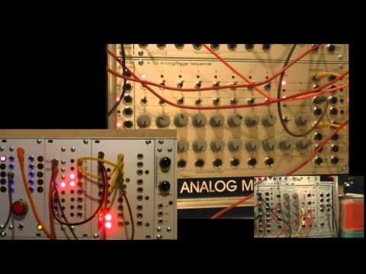
Example: Berlin-style Sequencing

Slide 10
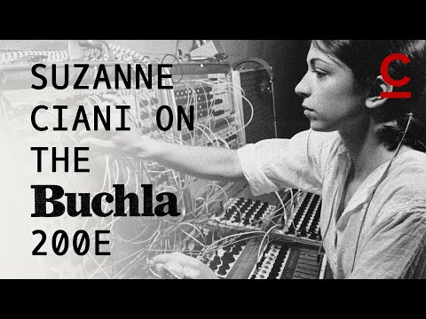
Example: Suzanne Ciani

Slide 11

Example: Spore (EAPd)

Slide 12
—-------------------------------------------------------------------

Slide 13
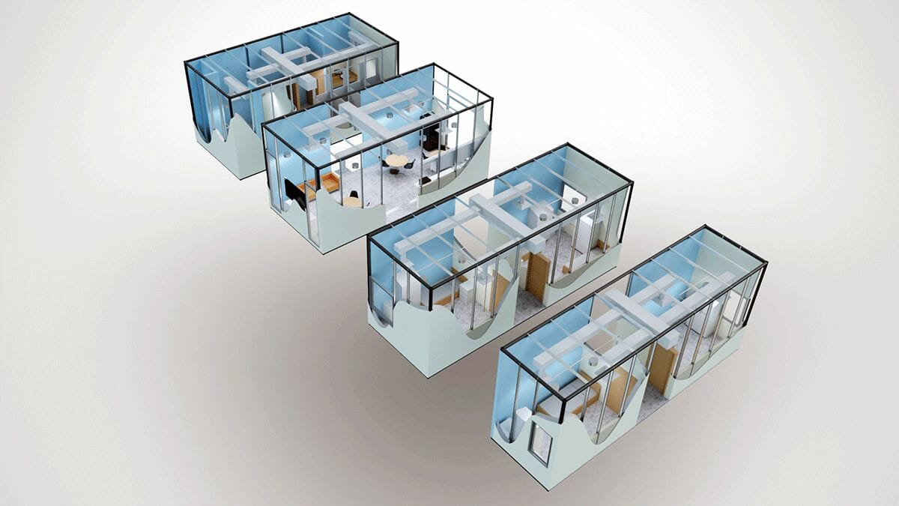
Building a sequencer…
in a modular way

Slide 14
Why Modular?
Break down more complex systems into simpler functions that are more easily understood.
Ability to reuse modules - save time/effort in future.
Development can be largely in parallel.*
* Particularly relevant if working in a team.

Slide 15
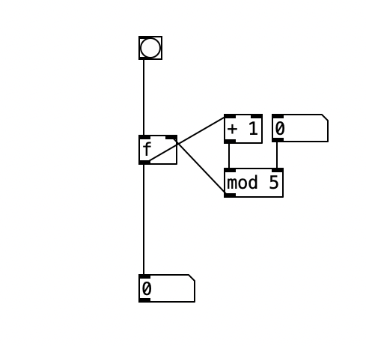
Building a Counter

Slide 16
Building a Counter - Key Concepts
Hot inlets - the leftmost inlet of any object is always a hot inlet. Whatever an object receives to the hot inlet will trigger the object and create an output.
Cold inlets - all other inlets are cold inlets. Whatever the object receives to them, it stores as a value, but does not output anything.
Modulo operator - the remainder of dividing two numbers.

Slide 17
Building a Counter - Development (see Pd patch 1)
Number box to HOT inlet of [float]. Value appears at output immediately.
Number box to COLD inlet of [f]. Value is stored (no output).
Number box to COLD inlet of [f]. Bang to HOT inlet output stored value.
Bang outputs the value stored in [f]. That output is passed through [+ 1] and then stored again (infinite counter).

Slide 18
Building a Counter - Development (see Pd patch 1)
A modulo function after [+ 1] can be used to set the sequence length. [mod] outputs the remainder of: the counter total divided by the desired sequence length (5 steps in the example).
Adding a number box to the cold inlet of [mod] lets us vary the sequence length on-the-fly.

Slide 19
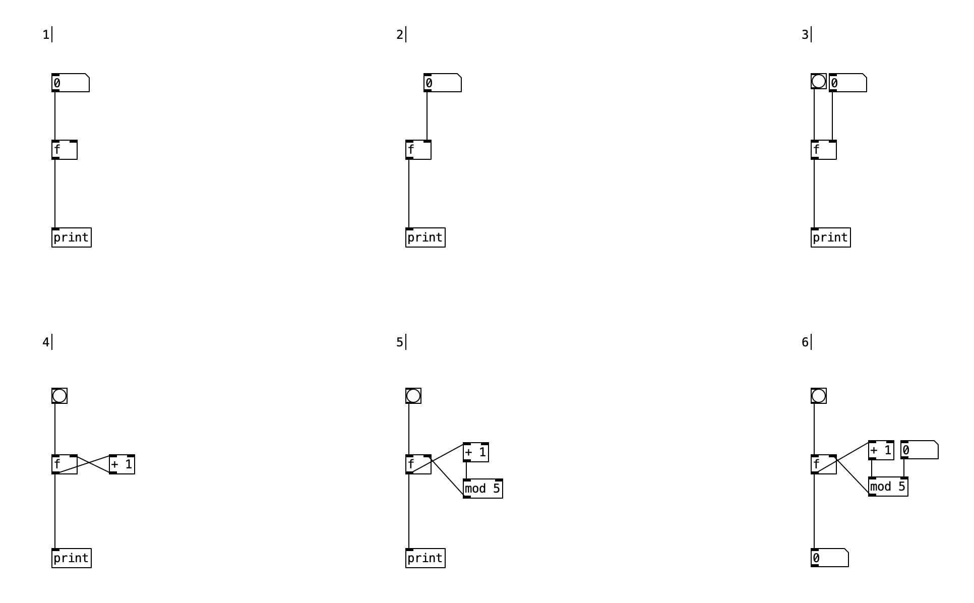
Notes:
https://github.com/matdwlv/bcu/blob/main/1_counter.pd

Slide 20
Now, build the counter….

Slide 21
Elements of a Simple Sequencer (see Pd patch 2)
Metronome (variable rate)
Counter
Step selection
MIDI Note generation (or sound generation)

Slide 22
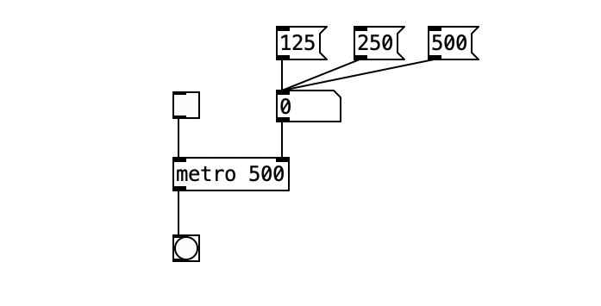
Metronome

Slide 23
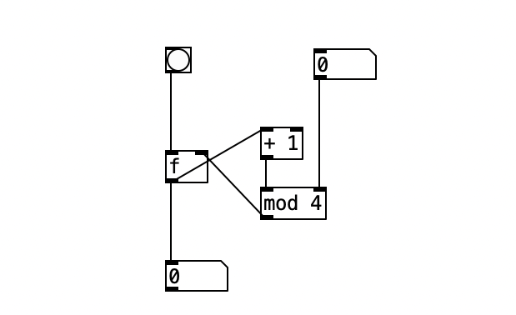
Counter

Slide 24
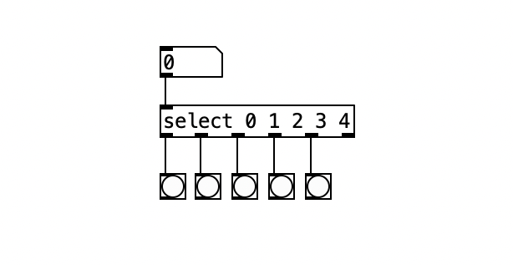
Step Selection

Slide 25
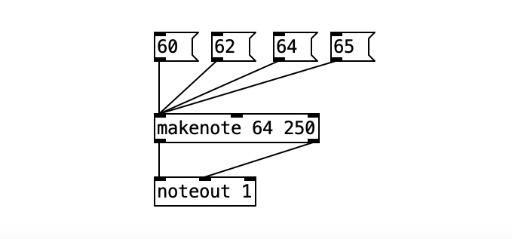
Note Generation

Slide 26
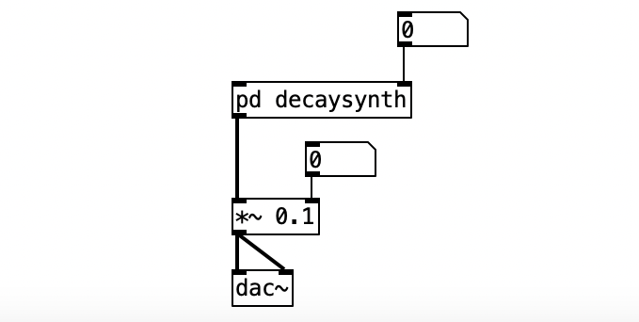
(we could also use simple sound output instead)
MIDI note in
Decay time (ms)

Slide 27
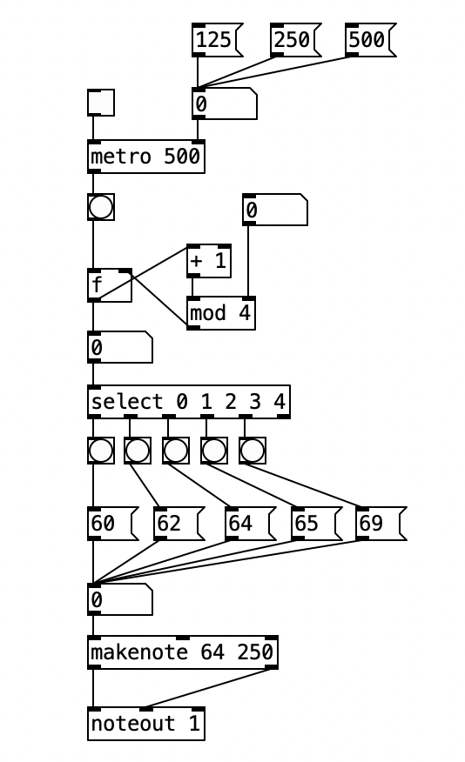
Now, put the elements together (see Pd patch 3):

Slide 28
—-------------------------------------------------------------------

Slide 29
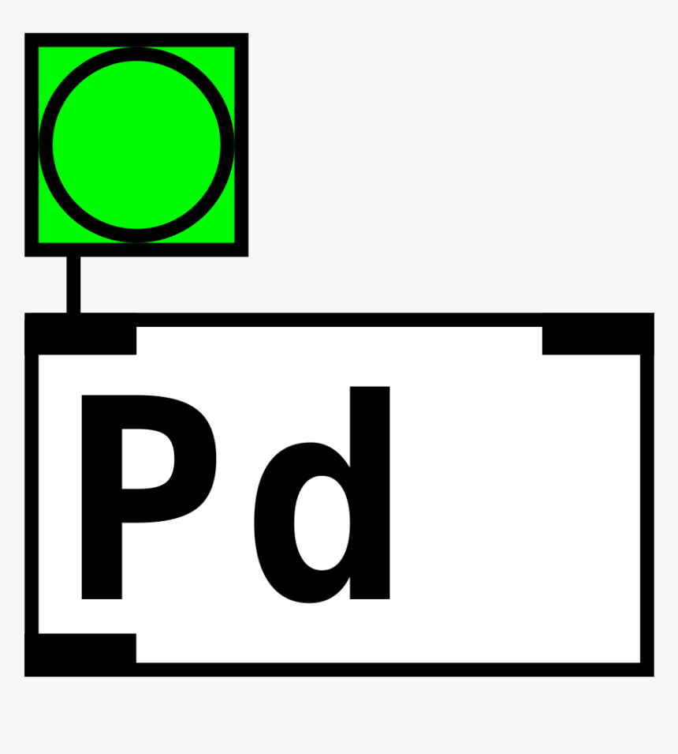
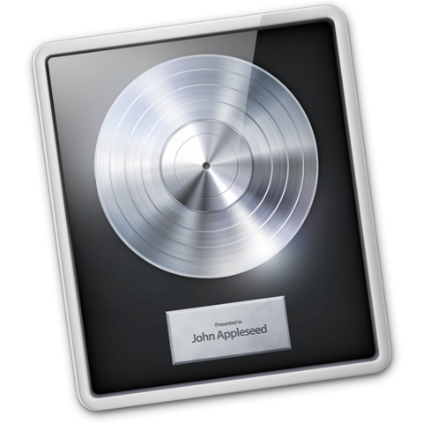
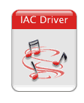

Slide 30
IAC Driver
IAC = Inter-Application Communication
An inbuilt MIDI device that enables MIDI messages to be routed between applications that support IAC.
e.g. to route MIDI messages from Pd to Logic.
Usually offline by default (see next slide)

Slide 31
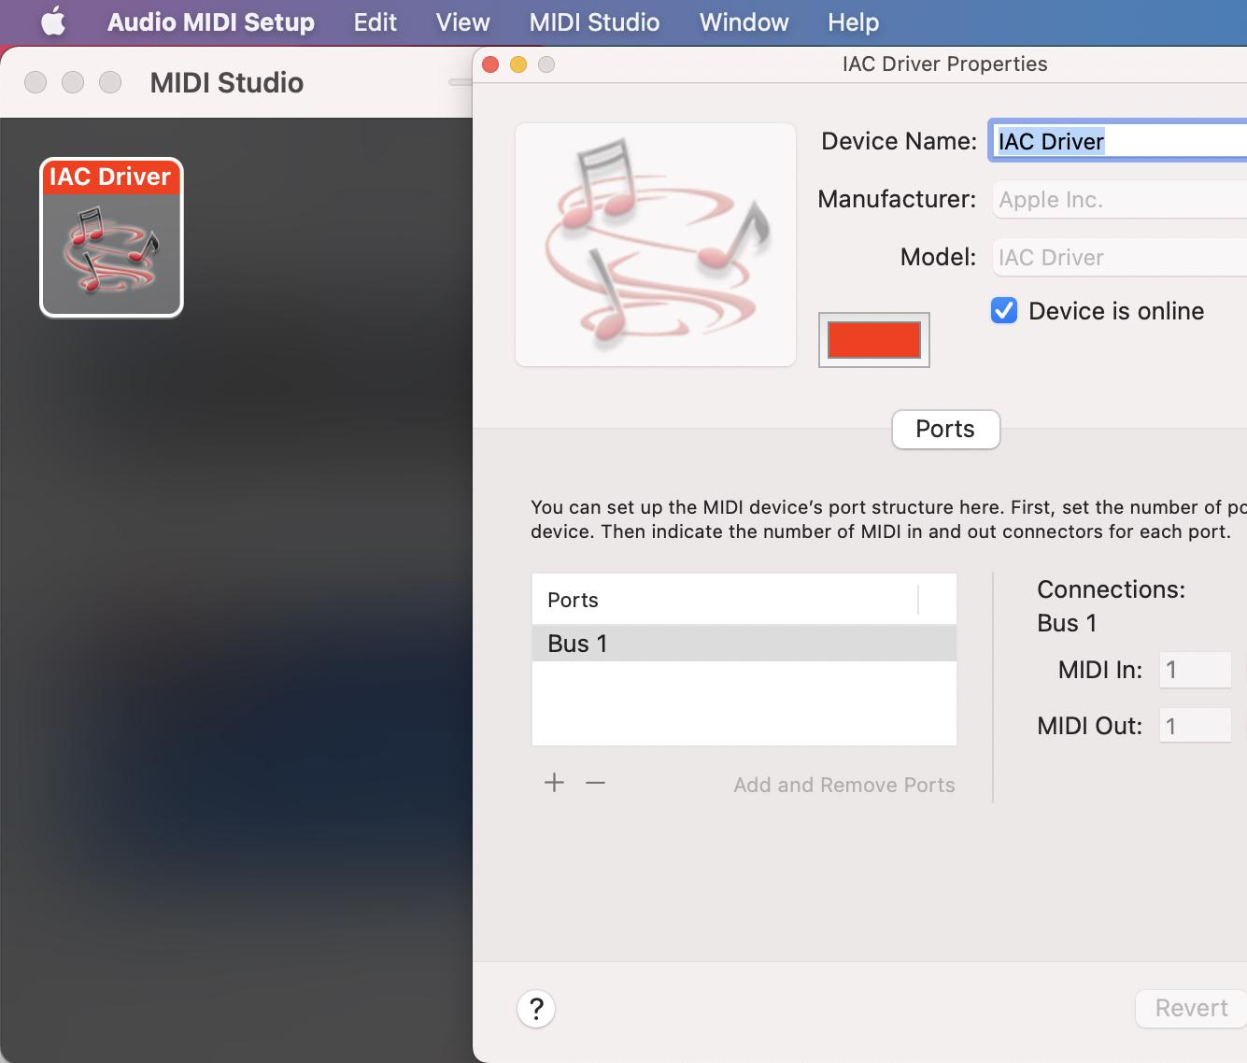
Go to:
Applications => Utilities
Audio MIDI Setup utility
Ensure Device is online is ticked.

Slide 32
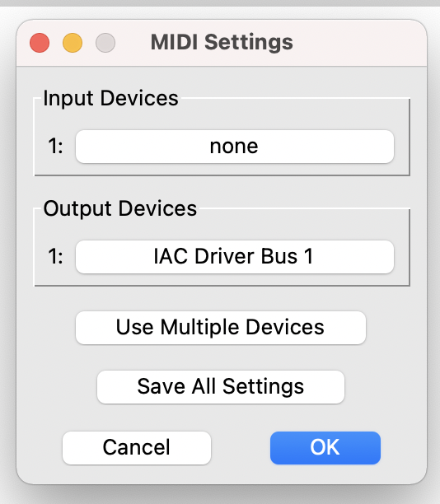
In Pd, go to:
Media => MIDI Settings
Set Output Devices (1) to IAC Driver 1
Then click OK (video here)

Slide 33
IAC into Logic Pro
Open the Logic Pro application
File => New Project
Create a Software Instrument track (video here).
Experiment with:
Manipulating and/or editing the Pd patch
The synthesizers available in Logic.

Slide 34
—-------------------------------------------------------------------

Slide 35
Explore [counter]
[counter] from the Cyclone library can replace your own counter.
It adds useful additional functionality:
Reset (see Flutter by Autechre)
Set/switch direction (up/down/alternating)
Set min and max values
Count how many times the maximum is reached.

Slide 36
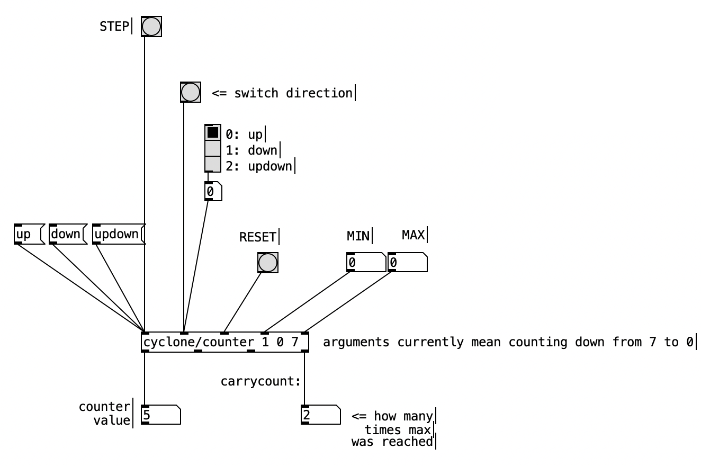

Slide 37
Task (by next week)
Add at least two extra features (see next slide) to the final Pd patch from today.
Record a 2 minute video screen capture that talks us through your ideas.
Upload it to XXXX by XX:XX on XXXX.

Slide 38
Ideas for Further Development
Subpatch and develop the GUI - foreground main controls, minimise clutter.
Add multiple rows of sequencing - try sequencing multiple synthesis parameters.
Use multiple sequencers at the same time - potential for polyrhythms, sequencing the sequencers.
Your ideas?

Slide 39
Bibliography
Elsea, P. (2018) Notes on Modular Synthesizers. Lulu.
Farnell, A. (2010) Designing Sound. MIT Press.
Jolly, K. (2011) Using Pd in Spore and Darkspore [online]. Available at: https://www.uni-weimar.de/kunst-und-gestaltung/wiki/PDCON:Conference/Using_Pure_Data_in_Spore_and_Darkspore [Accessed 22 June 2022].
Kreidler, J. (2013) Programming Electronic Music in Pd. Wolke Publishing House.
Puckette, M. (2007) Theory and Technique of Electronic Music. World Scientific Press.

